Slide 1

Supply Chain Management Presented by P.Gangadhar

Slide 2
Index
KPI Observations & Analysis
Excel Dashboard
Power Bi Dashboard
Tableau Dashboard
MySQL queries
Insights /Recommendation
Challenges

Slide 3

KPI ‘s Observations& Analysis 1. Total Sale (MTD ,QTD,YTD):
Month-to-Date (MTD) Sales
Sales accumulated from the beginning of the current month to the present date.
Observations:
Positive Trend: MTD sales are on track or exceeding expectations, it indicates strong sales performance for the month.
Insights:
Highlight top-selling products or regions driving MTD growth.
Quarter-to-Date (QTD) Sales
Sales accumulated from the beginning of the current quarter to the present date.
Observations:
Comparison with Previous Quarters: Analyze QTD performance against the same period in previous quarters to identify growth trends or slowdowns.
Performance Drivers: Identify which products(Hobbies& Art) , regions(west), or channels are contributing most to QTD sales.
Insights:
Redirect resources toward high-performing products or regions to sustain momentum.
Address underperforming areas by revising strategies (e.g., pricing, inventory)

Slide 4

Total Sale (MTD ,QTD,YTD):
Year-to-Date (YTD) Sales
Sales accumulated from the beginning of the year to the present date.
Observations:
Annual Growth Trend: Evaluate YTD growth compared to the same period in previous years to understand long-term sales trends.
Goal Alignment: Compare YTD sales with annual targets to measure progress.
Insights:
Identify the impact of major campaigns, seasonality, or economic factors on YTD sales.
Adjust strategies to meet or exceed annual targets if YTD performance is lagging.

Slide 5
2. Product Wise Sales:
Observation & Insights
Identify high-performing products contributing the most to revenue.-Focus marketing efforts on bestsellers or explore bundling opportunities for low-performing products.
Products with low sales but high margins could be prioritized for niche markets.- Discontinue or improve efficiency for low-margin products
Products with low turnover rates might be overstocked, leading to higher holding costs.- Consider clearance strategies or stock reduction for slow-moving items
Identify seasonal demand patterns for products.- Adjust production and inventory strategies to align with peak demand periods.
Products with high return rates could indicate quality or fit issues.-Investigate underlying problems and address them to improve customer satisfaction
Products with stagnant ASP might require reevaluation of pricing strategies.-Introduce promotions or adjust pricing to stay competitive
Products with low delivery performance may indicate logistical challenges.-Optimize routes or prioritize certain products in the supply chain.
Track the impact of promotions and campaigns on specific products.-Repeat successful strategies or refine ineffective ones.
High stock-out rates for certain products may indicate supply chain inefficiencies.-Improve demand forecasting or supplier performance.

Slide 6

3. Sales Growth KPI:
Sales growth is a critical KPI for evaluating the performance and trajectory of a business.
Steady Growth: Indicates the business has sustainable demand, effective strategies, and consistent market positioning
Growth from one-off events (e.g., promotions) may not reflect true business expansion.
Compare growth with industry peers to understand competitive positioning.
Sales growth reflects the health of a business. While positive growth is encouraging, it is critical to analyze the sustainability and drivers behind it.

Slide 7
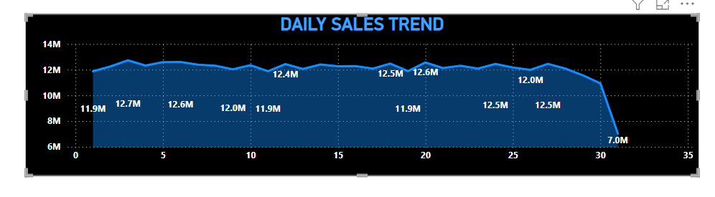
4. DAILY SALES TREND:
OBSERVATION:
IN DAILY SALES TREND OBSERVED THAT IN EVERY MONTH FROM DAY 1 -30 THE SALES AROUND 11M-13M
WHERE AS COMING TO 31st DAY NOTICED THAT SALES FALLS DOWN 7M DUE TO IN A YEAR ONLY FEW MONTHS HAS DATE 31st

Slide 8
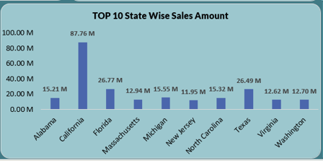
5. STATE WISE SALES:
OBSERVATION:
TOTAL 37 STATES THERE ARE AND TOTAL SALES OF STATES ARE 373M
AVERAGE STATE WISE SALES IS 10.08M
AND 11 STATES SALES WHICH ARE MORE THAN AVG SALES
AND TOP5 AND BOTTOM5 STATE-SALES REPRESENTS THE VISUALS

Slide 9
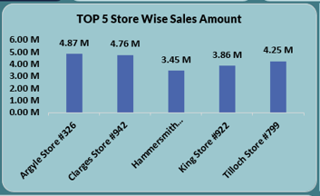
6. TOP5-STORES:
OBSERVATION:
OVERALL, THERE ARE 200 STORES ACROSS THE ALL STATES
THE FOLLOWING VISUAL SHOWS THE TOP5 STORES
AND TOTAL SALES OF TOP5 STORES IS 21.2M

Slide 10
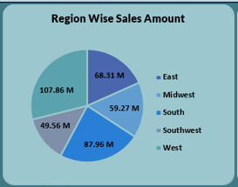
7.REGION WISE SALES:
OBSERVATION:
HERE COMING TO REGION WISE SALES THE HIGHEST SALES
IS WEST REGION ALMOST IS 108M AND WEST CONTAINS HIGHEST SALES STATE CALIFORNIA AND
ALSO MORE NO. OF STORES(50+) IN WEST
AND LOWEST REGION SALES IS SOUTHWEST i.e NEAR 50M

Slide 11
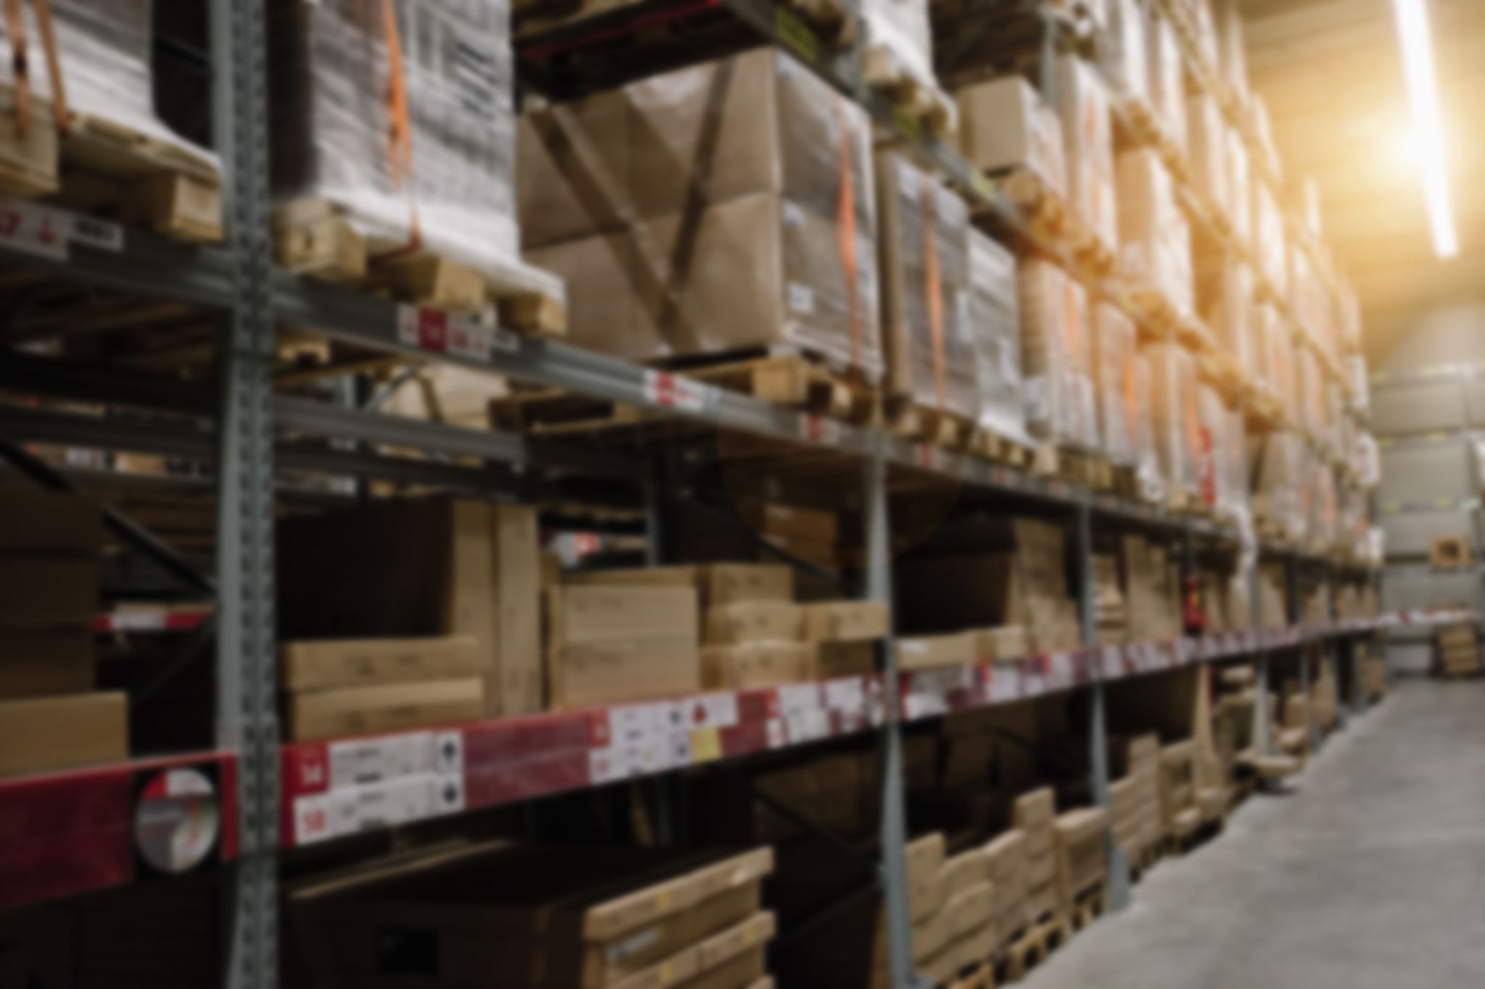
8. Total Inventory:
The total quantity of items (products) currently available across warehouses, stores, or distribution centers.
It reflects the overall stock level, which is critical for meeting customer demand without overstocking or understocking
Purpose of the KPI:
Monitor Stock Levels: Helps stakeholders understand the current inventory position.
Optimize Inventory Management: Provides insight into whether inventory levels are balanced or require adjustments.
Identify Risks:
Overstocking: If the inventory is too high, it could lead to increased holding costs and potential waste for perishable items.
Stockouts: If inventory is too low, it may lead to missed sales opportunities or delays in fulfilling orders.

Slide 12

9.Inventory Value:
The total cost (or sometimes the retail value) of all items currently in stock. It is usually calculated as:
Inventory Value=Quantity of Stock × Unit Cost
Purpose of the KPI
Financial Insights: Helps understand the financial investment tied up in inventory.
Cost Management: Assists in monitoring how much capital is locked in stock, enabling better cost control.
Stock Valuation: Aids in identifying underperforming or overstocked inventory that might not justify its cost.
Support Decision-Making:
Highlights areas where inventory levels may need adjustment to optimize cash flow.
Helps determine which products may require discounting or faster sales turnover to reduce holding costs.

Slide 13
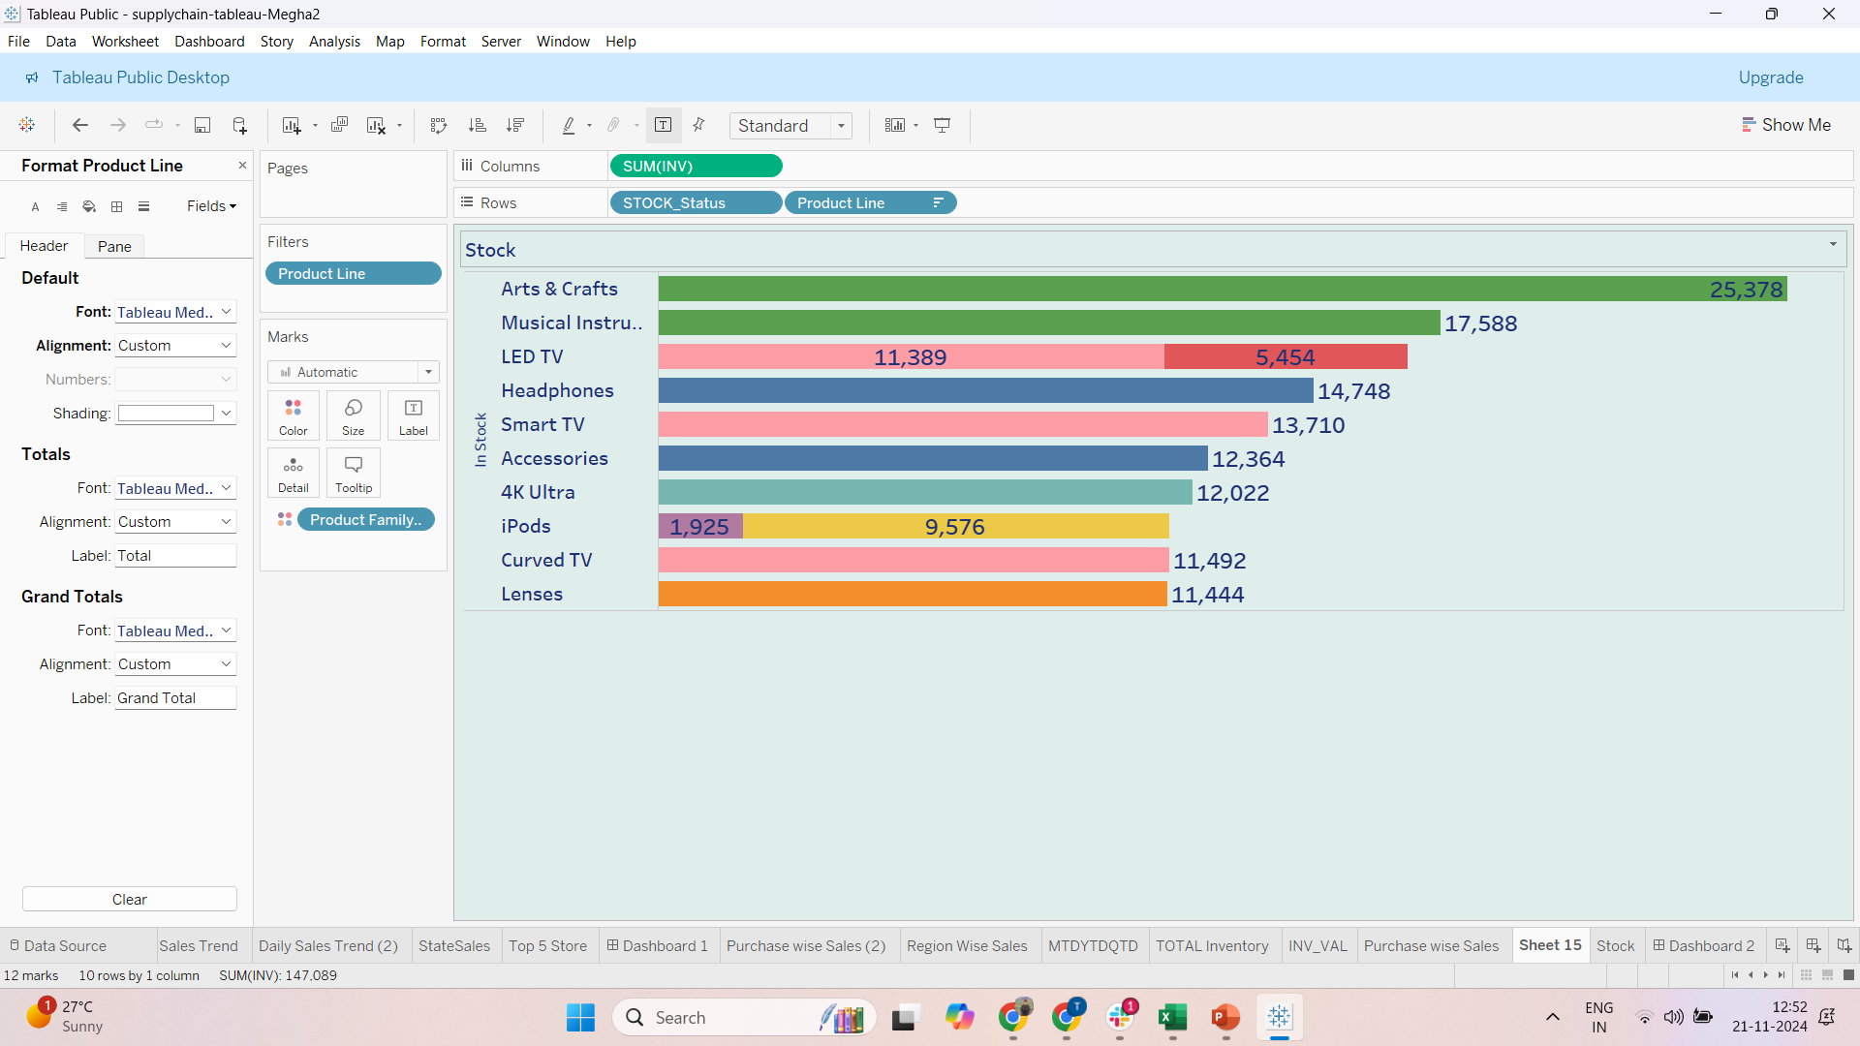
10. Overstock KPI:
High values in the Overstock KPI indicate excessive inventory, leading to increased carrying costs and potential obsolescence.
Frequently overstocked items may highlight poor demand forecasting or supplier overcommitment.
Persistent overstock suggests a need for better sales and marketing alignment to clear inventory or revise reorder thresholds.
Insight
Overstock KPIs are linked to lower efficiency and reduced cash flow.
Keep Inventory Balanced: Use accurate forecasts and check KPIs regularly to maintain the right stock levels.
Use Data Insights: Analyze trends to improve purchasing, restocking, and stock distribution.
Automate Management: Use tools to track inventory in real time and predict stock needs.
Work as a Team: Coordinate with all departments for better inventory handling

Slide 14
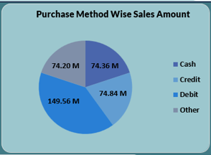
11. Purchase Wise Method Sales:
Observations –
Higher Debit card transactions often show a preference for small to medium-value purchases. Customers opting for this method usually exhibit a higher level of financial discipline and aim to avoid debt.
Insight-
Businesses can target such customers with loyalty programs focusing on discounts for repeat purchases. Additionally, partnerships with banks to incentivize debit usage could boost customer retention.
Tailoring promotions and infrastructure support to each payment method can maximize conversions
By aligning promotional strategies and infrastructure investments with specific purchase methods, businesses can optimize conversions and drive higher engagement with diverse customer segments.

Slide 15
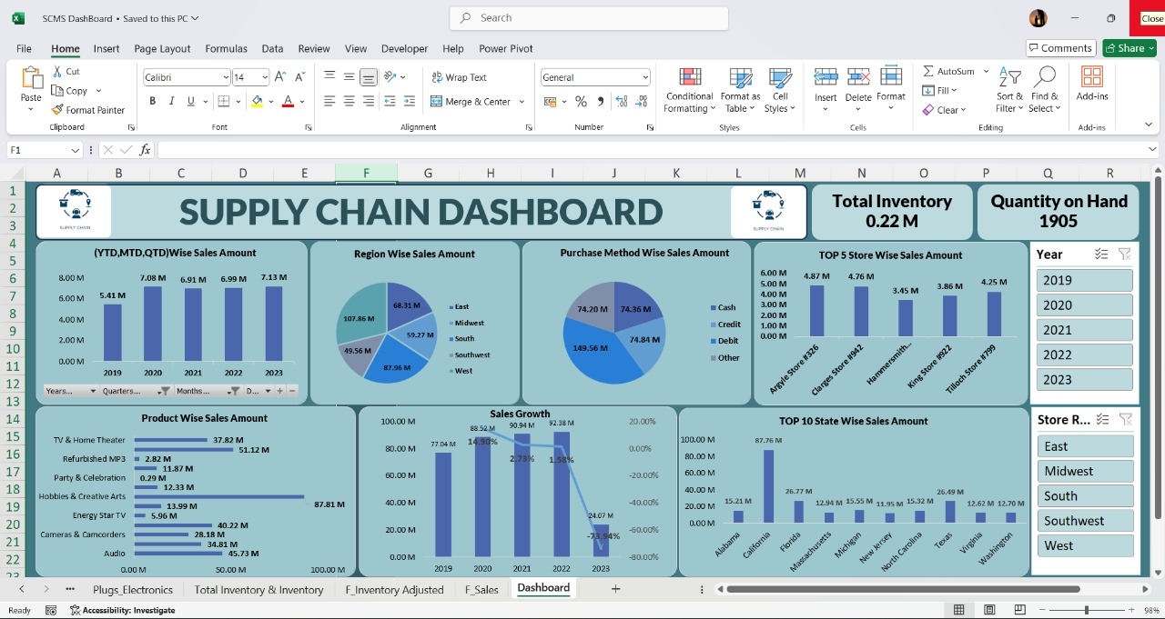
Excel Dashboard

Slide 16
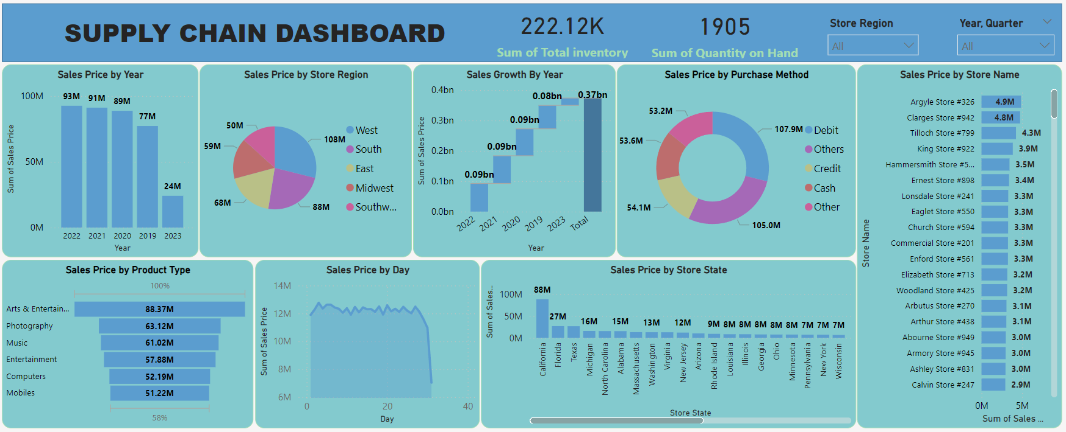
Power BI Dashboard

Slide 17
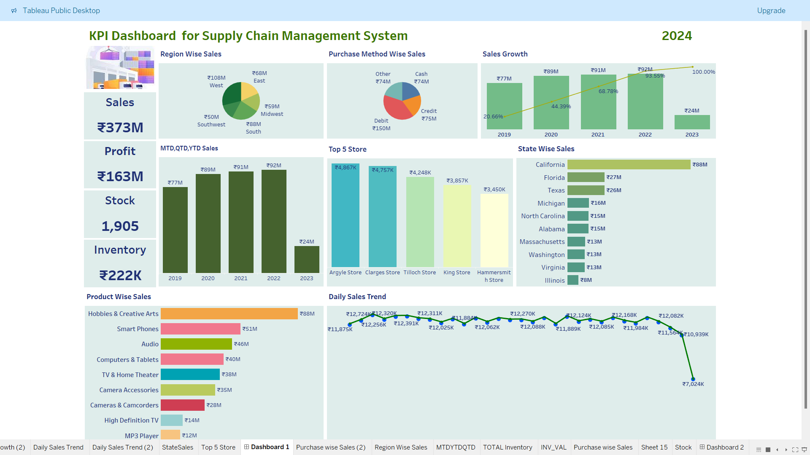
Tableau Dashboard

Slide 18
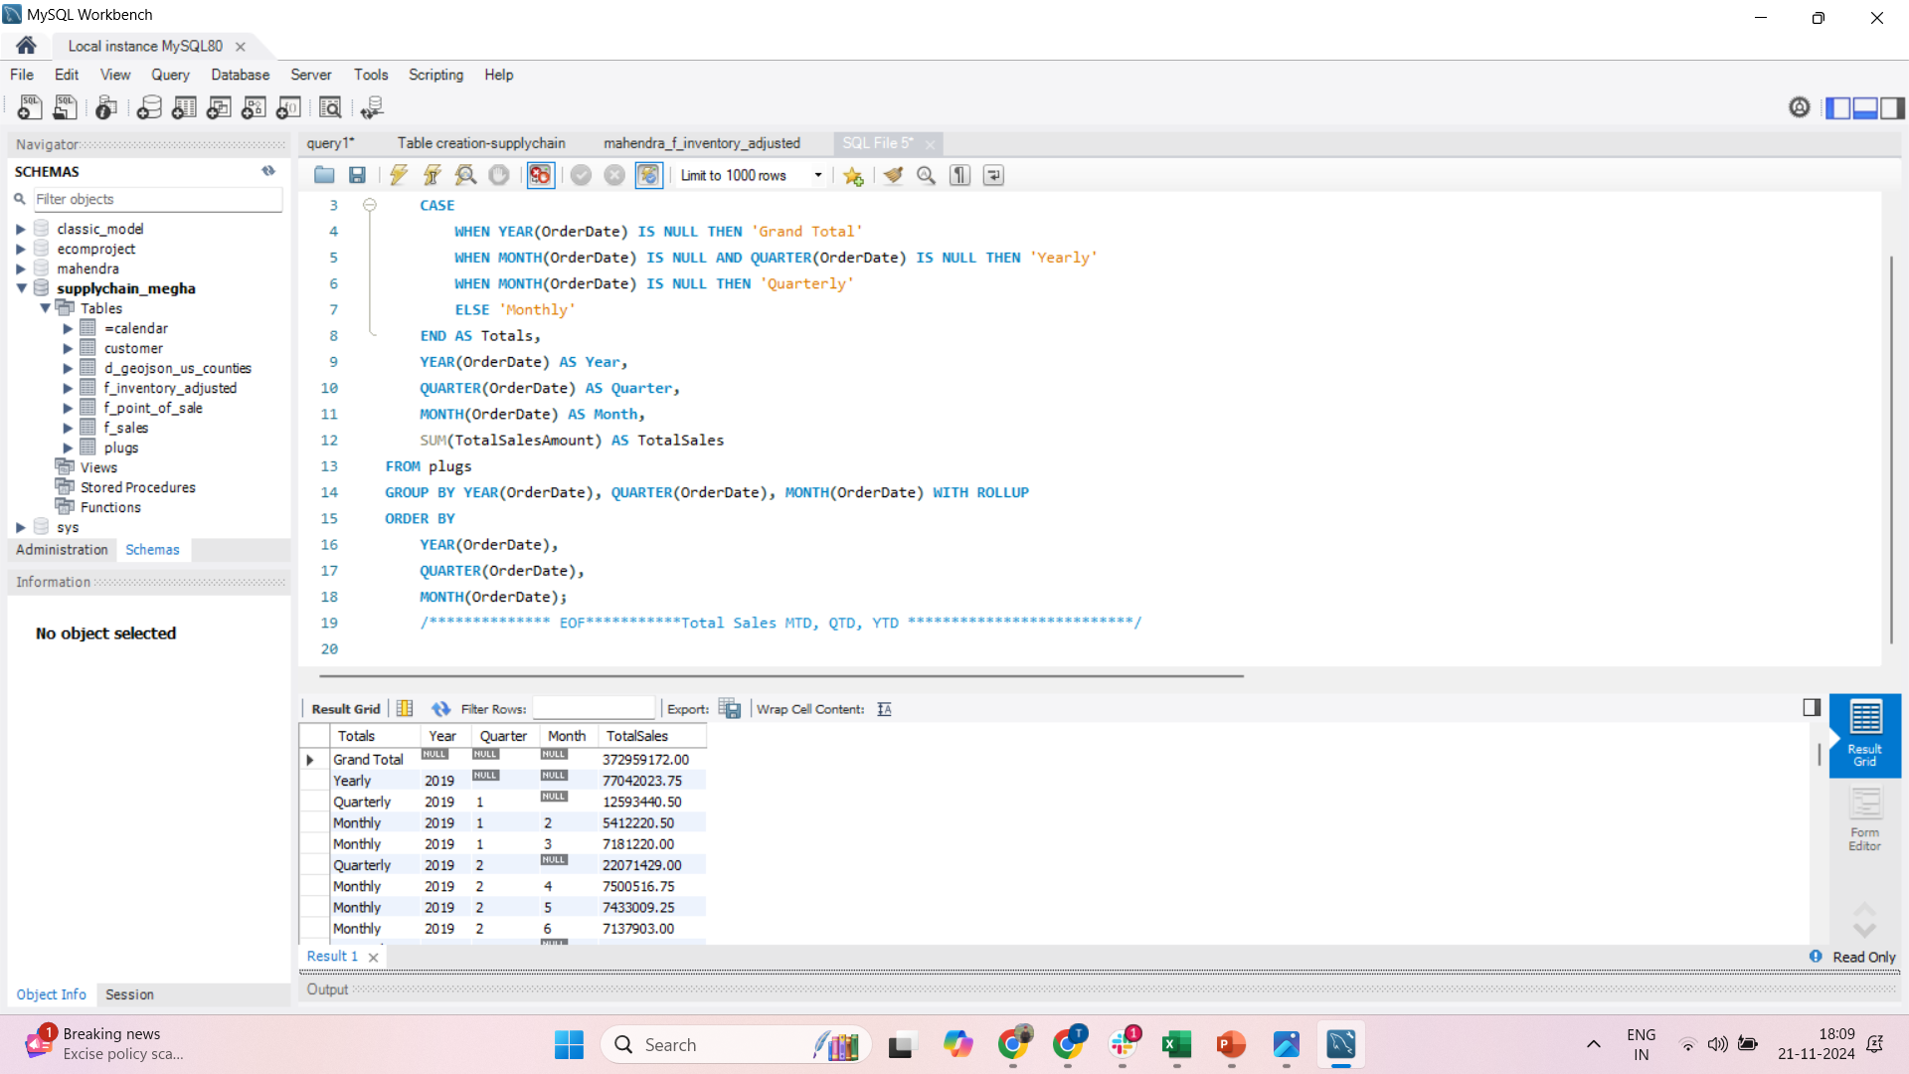
SQL Query:
KPI Total Sales (MTD, QTD, YTD)

Slide 19
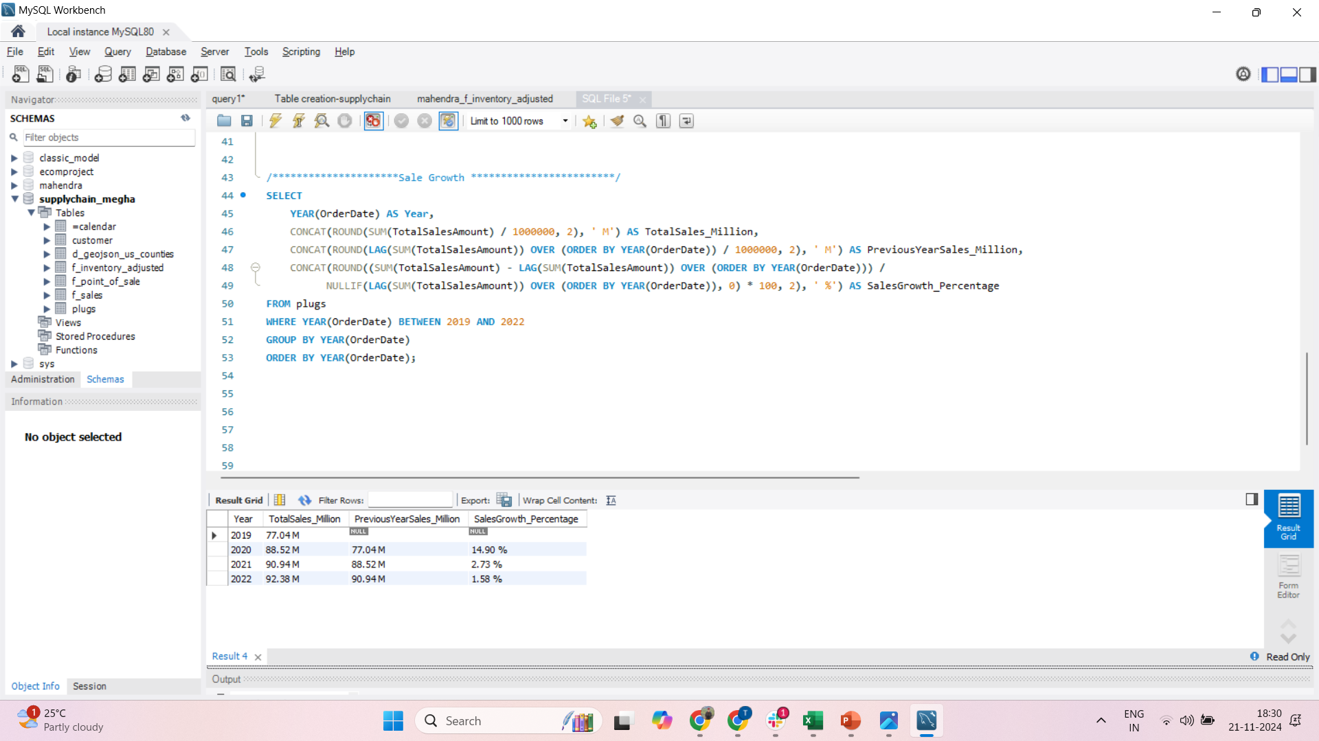
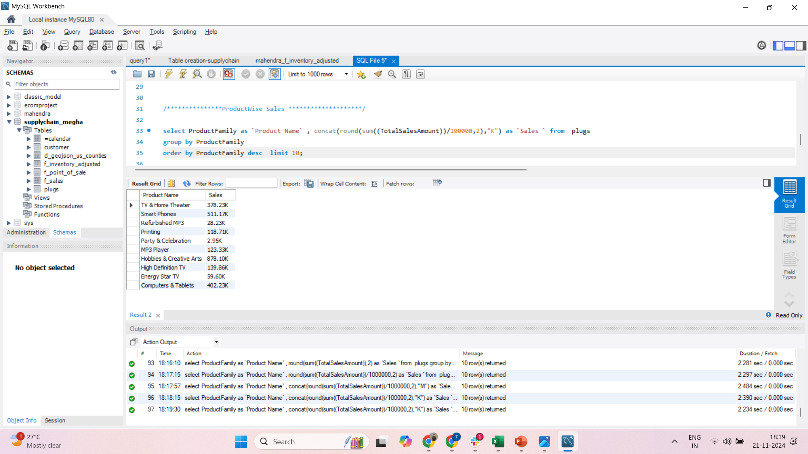
Product Wise Sales :

Slide 20
Sales Growth :

Slide 21
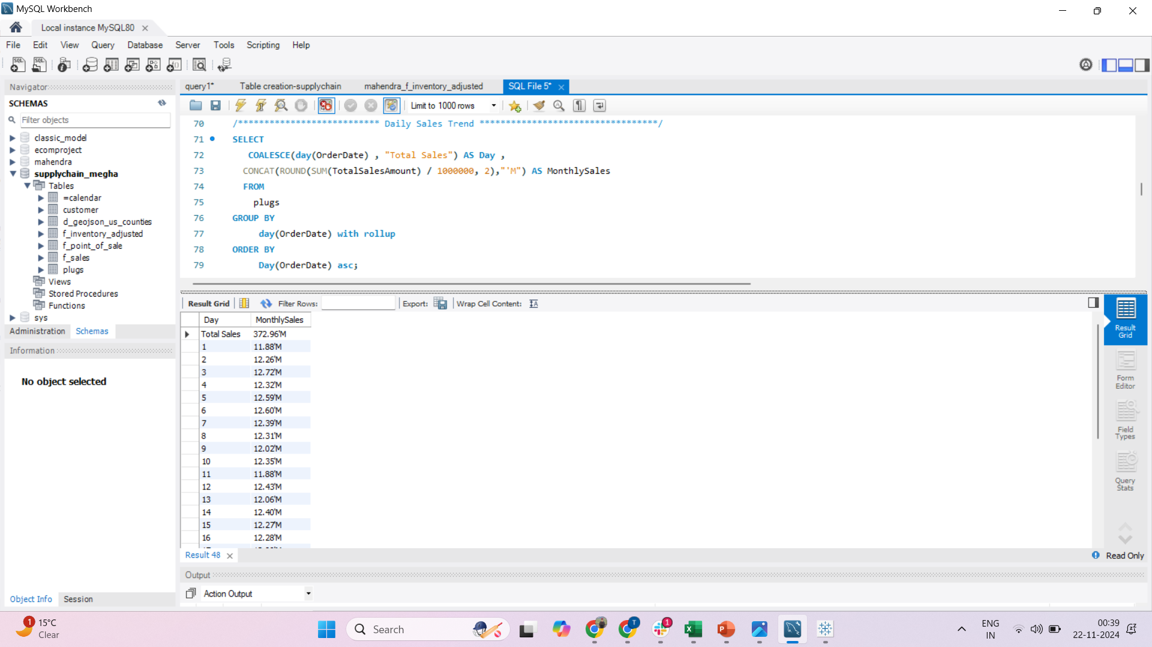
Daily Sales Trend :

Slide 22
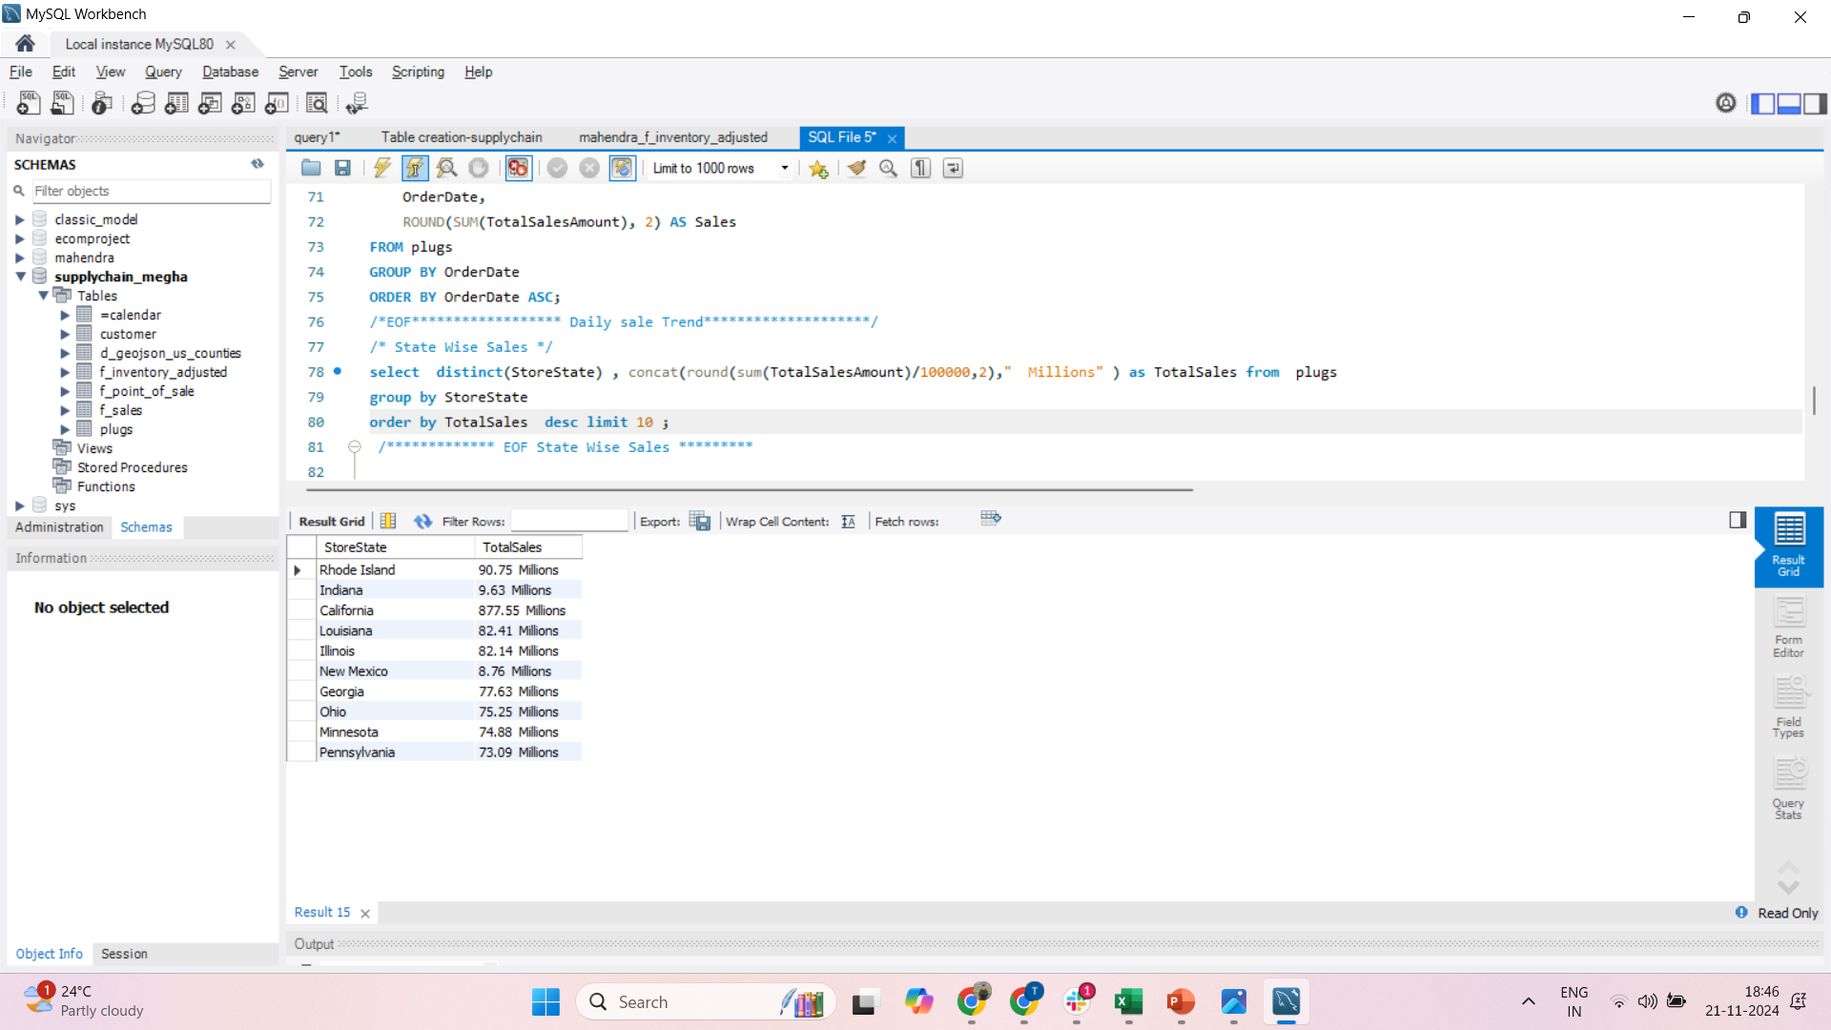
State Wise Sales :

Slide 23
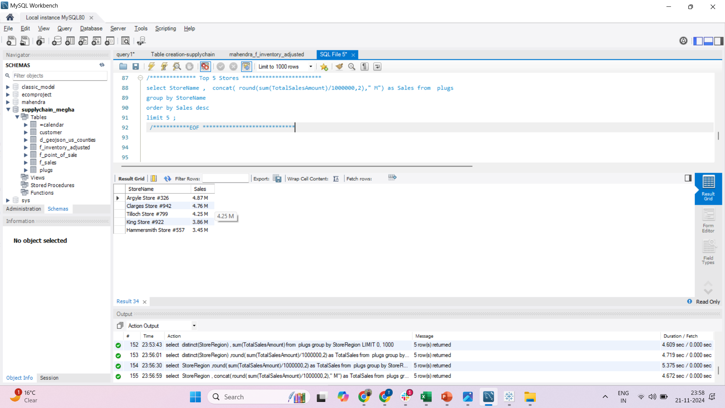
Top 5 Stores :

Slide 24
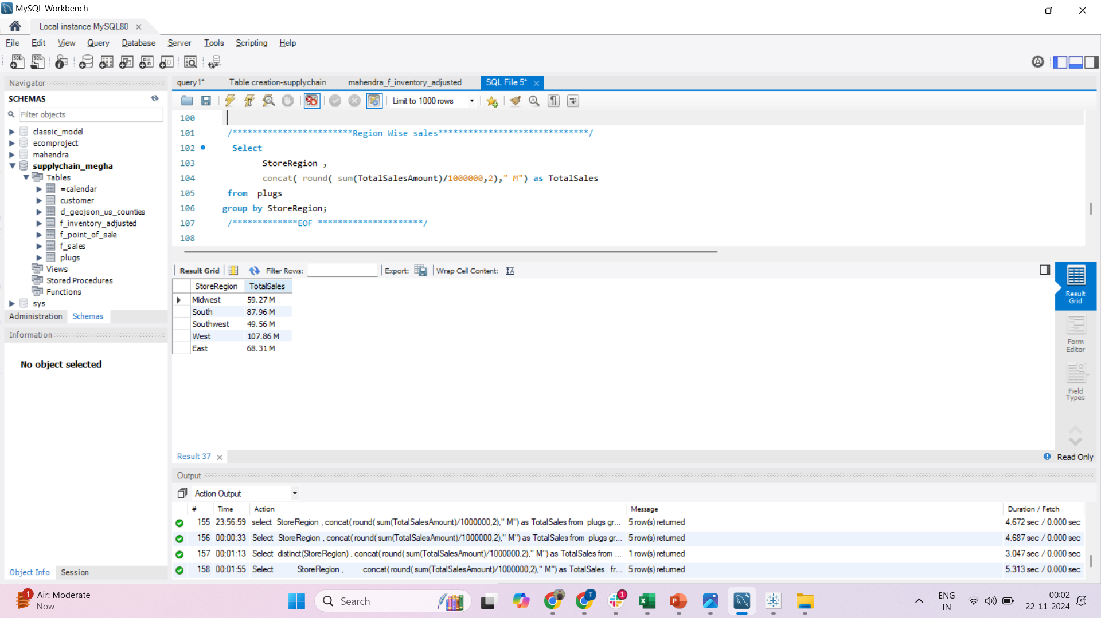
Region Wise Sales :

Slide 25
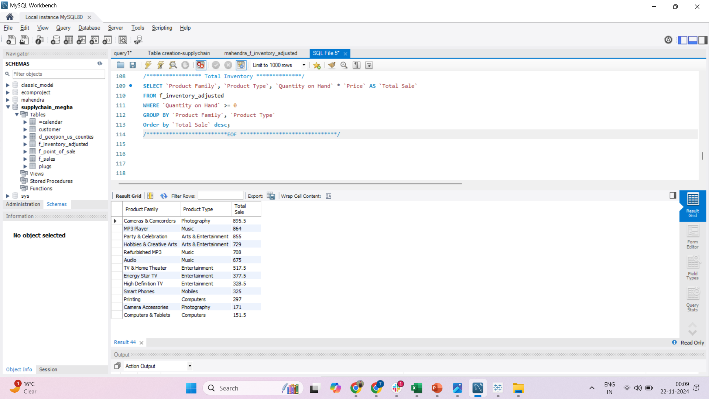
Total Inventory Sales :

Slide 26
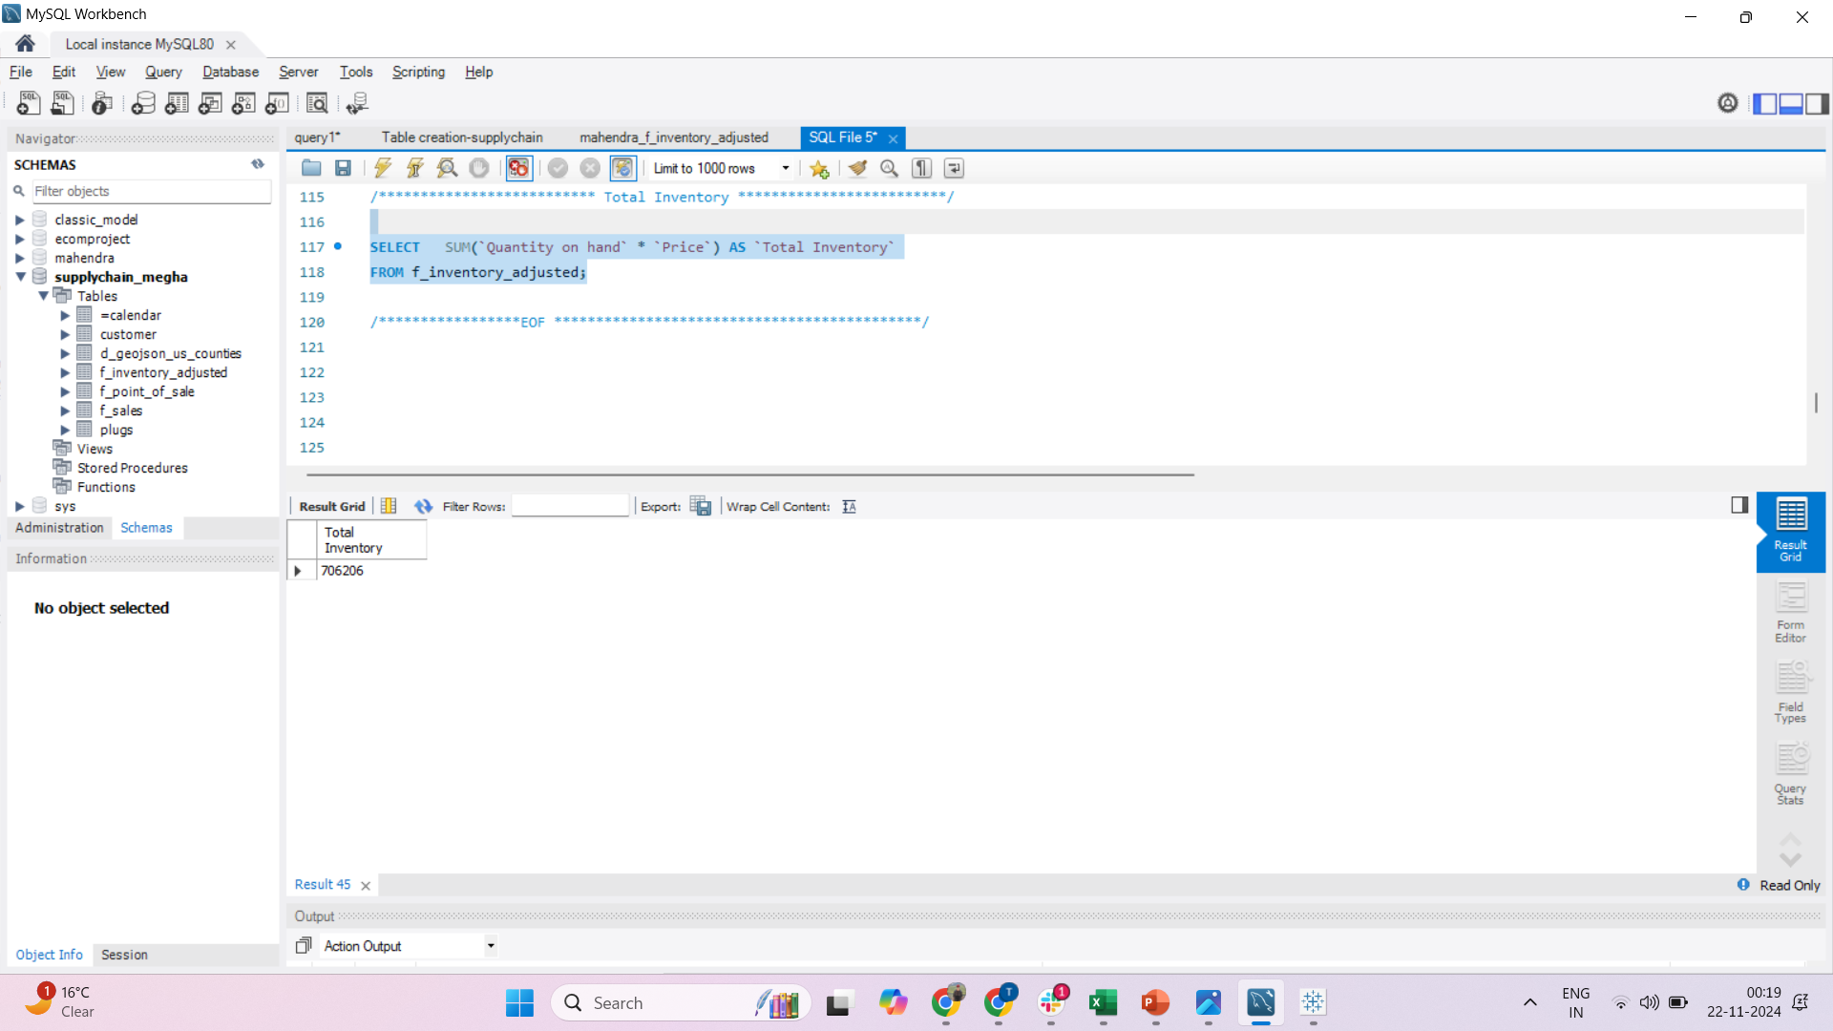
Inventory Values:

Slide 27
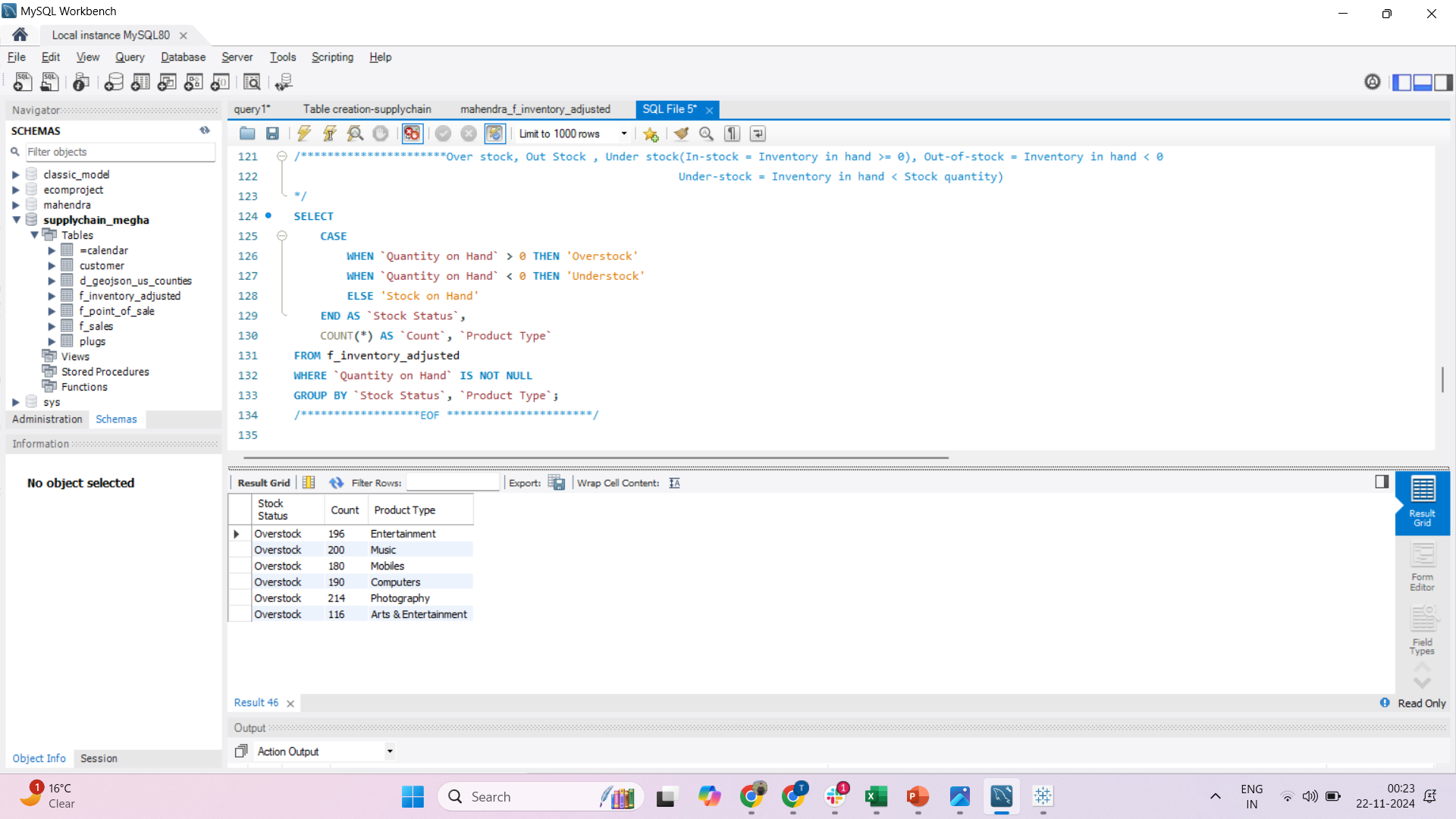
Over stock, Out Stock , Under stock:
(In-stock = Inventory in hand >= 0), Out-of-stock = Inventory in hand < 0 Under-stock = Inventory in hand < Stock quantity)

Slide 28
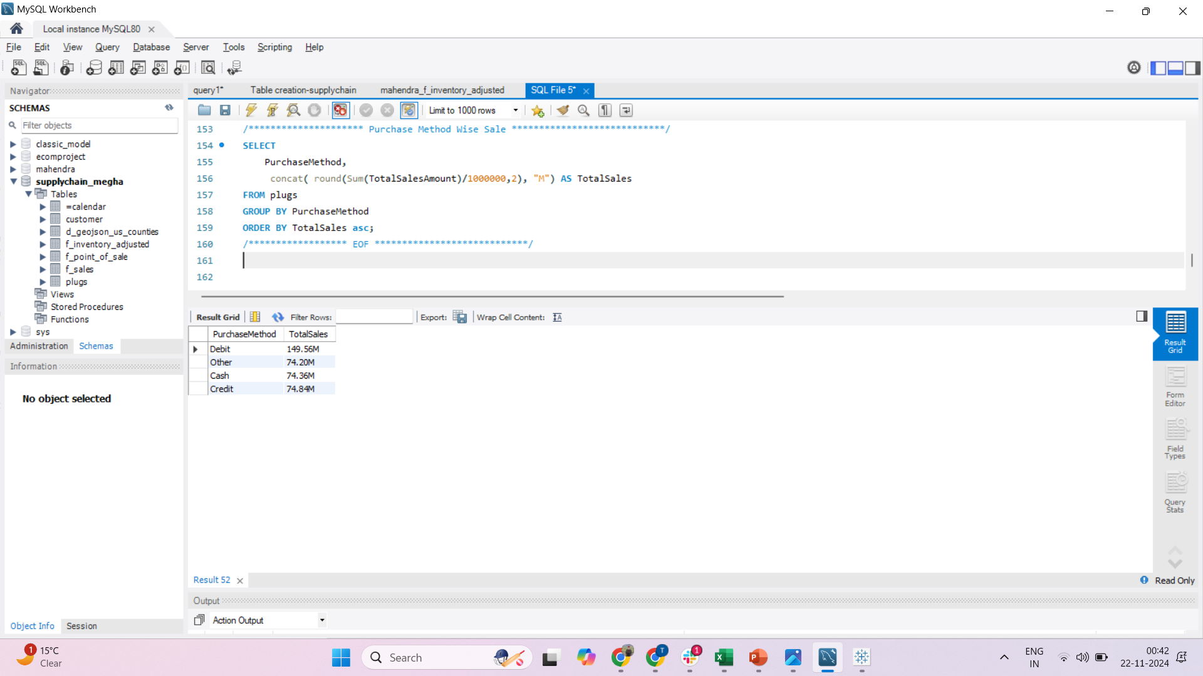
Purchase Method Wise Sales:

Slide 29

Recommendations:
Develop personalized promotions for top customer segments to boost growth.
Total Sale
Optimize lead-to-sale conversion for a stronger impact on MTD and QTD performance
Offer incentives like limited-time discounts to convert prospects into customers quickly.
Use YTD trends to adjust yearly goals and resource allocation.
Expand into new markets or strengthen offerings in existing high-growth areas
Address pain points (e.g., pricing, service quality) identified in customer feedback
Product wise KPI
By creating Quarterly , Monthly Product wise KPI easily identifying bottlenecks, automate your sales process for lead generation, qualification, sales pipeline analysis and nurturing, you can free up your sales team to focus on more important tasks. This can lead to increased sales and improved customer service.
Focus on underperforming regions or products and invest in high-potential areas
Ensure growth aligns with the company’s capacity to manage increased demand effectively.

Slide 30

3) Sales Growth -Sales Growth KPI provides valuable insights into how sales performance is impacted by and interacts with supply chain processes. -This KPI ensures alignment between demand generation (sales) and supply chain capabilities (procurement, production, and distribution). 4) Daily Sales Trend -The Daily Sales Trend KPI in a Supply Chain Management (SCM) dashboard focuses on real-time tracking of sales trends to help supply chain managers adjust operations dynamically. -This KPI is particularly useful for identifying daily fluctuations in demand and ensuring the supply chain is agile enough to respond efficiently. 5) State Wise Sales -A State-Wise Sales KPI in a Supply Chain Management (SCM) dashboard provides critical insights into regional demand patterns, enabling supply chain teams to optimize operations based on geographic performance. - This KPI ensures that supply chain resources—inventory, logistics, and distribution—are aligned with the sales performance in each state.

Slide 31

6) Top 5 Store Wise Sales -The Top 5 Store-Wise Sales KPI in a Supply Chain Management (SCM) dashboard focuses on identifying the best-performing stores and understanding how their operations impact the supply chain. -By analyzing store-wise sales, supply chain managers can optimize inventory allocation, logistics, and distribution to support top-performing locations and address challenges in others. 7) Region Wise Sales
-A Top Region-Wise Sales KPI in a Supply Chain Management (SCM) dashboard highlights sales performance across different regions, helping supply chain teams prioritize operations in areas driving the most revenue. By focusing on top-performing regions, the dashboard can provide actionable insights to optimize inventory, distribution, and logistics while identifying opportunities for growth or efficiency improvements.

Slide 32

8)Total Inventory
Total Inventory KPI in represents the current stock of all products available in the supply chain.
We can compare inventory levels against sales trends to adjust procurement or production schedules.
When combined with sales data(Sales Growth ), it can help calculate how quickly inventory is being sold and replenished.
Regional Analysis: Break down inventory by region to ensure stock availability matches regional demand.
9)Inventory value
Monitor Inventory Turnover: Compare Inventory Value with daily sales trends to identify slow-moving stock.
Balance Inventory Costs: Ensure the Inventory Value isn't excessively high for products with low demand to avoid financial losses.
Prioritize Valuable Stock: Focus on optimizing storage and sales of high-value items to maximize profitability.

Slide 33

10)Over Stock, Out Of Stock, Under Stock -Over Stock Tracks products or inventory exceeding the optimal levels required for operations or demand, leading to excess carrying costs. -Out of Stock Measures the frequency and impact of stockouts, where demand cannot be fulfilled due to insufficient inventory. -Under Stock Tracks situations where inventory is below the optimal level, posing a risk of stockouts but not yet leading to lost sales.

Slide 34


